Slide 1
Bresenham’s Line Drawing Algorithm
Nancy Victor
Assistant Professor
SITE, VIT University,
Vellore

Slide 2
DDA Algorithm Drawbacks
DDA is the simplest line drawing algorithm
  Not very efficient
  Round off operation is expensive
Optimized algorithms typically used.
  Integer DDA
  E.g.Bresenham algorithm
Bresenham algorithm
  Incremental algorithm: current value uses previous value
  Deals with integer addition, subtraction and multiplication by two.

Slide 3
Bresenham’s Line Drawing Algorithm
Basic Principle:
To find optimum raster locations to represent straight lines.
This algorithm always increments x or y by one unit depending on the slope of the line.
Increment in the other variable is found on the basis of the distance between the actual line location and the nearest pixel. This distance is called as the decision variable.
The vertical axis show scan line positions and horizontal axis identify pixel columns.

Slide 4
Bresenham’s Line Drawing Algorithm
Given two endpoints (x1, y1) and (x2, y2), we can chose the start point (xk, yk).
The choice is purely arbitrary, it can be either of (x1, y1) and (x2, y2) points.
From this start point or pixel, we have eight possible choices for the next pixel in the line, since each pixel is surrounded by 8 other pixels (except border pixels).
If we consider the scan conversion process for lines with positive slope less than 1, we can isolate two choices out of these 8 choices.

Slide 5
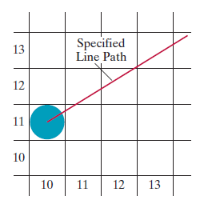
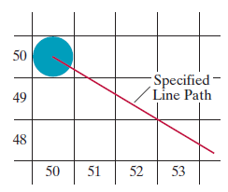
Bresenham’s Line Drawing Algorithm
We need to determine at the next sample position whether to plot the pixel at position (11, 11) or the one at (11, 12).
Do we select the next pixel position as (51, 50) or as (51, 49)?
We can find this by testing the sign of the integer parameter, that provides a measure of the relative distances of the two pixels from the actual position on a given line.

Slide 6
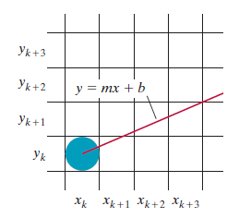
Bresenham’s Line Drawing Algorithm
For lines with positive slope less than 1, pixel positions are determined by sampling at unit x intervals.
Starting from (x₀,y₀) of a given line, we step to each x position and plot the pixel whose scan line y value is closest to the line path.
Assuming we have determined that the pixel at (xk , yk) is to be displayed, we next need to decide which pixel to plot in column
xk+1 = xk + 1.
Our choices are the pixels at positions (xk + 1, yk) and (xk + 1, yk + 1).

Slide 7
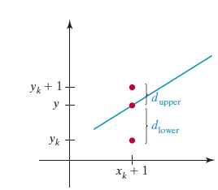
Bresenham’s Line Drawing Algorithm
At sampling position xk + 1, we label vertical pixel separations from the mathematical line path as dlower and dupper .
The y coordinate on the mathematical line at pixel column position xk + 1 is calculated as
y = m(xk + 1) + b

Slide 8
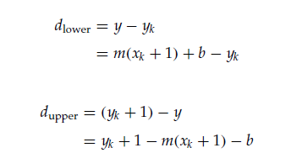
Bresenham’s Line Drawing Algorithm
To determine which of the two pixels is closest to the line path, we can set up an efficient test that is based on the difference between the two pixel separations:
dlower − dupper = 2m(xk + 1) − 2yk + 2b − 1

Slide 9

Bresenham’s Line Drawing Algorithm
A decision parameter pk for the kth step in the line algorithm can be obtained by rearranging the equation so that it involves only integer calculations.
We accomplish this by substituting m = dy/dx, where dy and dx are the vertical and horizontal separations of the endpoint positions, and defining the decision parameter as

Slide 10
Bresenham’s Line Drawing Algorithm
The sign of pk is the sameas the sign of dlower − dupper, since dx > 0 for our example.
Parameter c is constant and has the value 2dy + dx(2b − 1),which is independent of the pixel position and will be eliminated in the recursive calculations for pk.
If the pixel at yk is “closer” to the line path than the pixel at yk + 1 (that is, dlower < dupper), then decision parameter pk is negative.
In that case, we plot the lower pixel; otherwise we plot the upper pixel.

Slide 11

Bresenham’s Line Drawing Algorithm
At step k + 1, the decision parameter is
Let's get rid of multiplications
P_{k+1} - P_{k} = 2 ΔY (x_{k+1} - x_{k}) -2 ΔX (y_{k+1} - y_{k}) (get rid of the constants)
P_{k+1} = P_{k} + 2 ΔY - 2 ΔX (y_{k+1} - y_{k})
P_{k+1} = P_{k} + 2ΔY or
= P_{k} + 2(ΔY – ΔX(
with (y_{k+1} - y_{k}) = 0 or 1 depending on P_{k} sign

Slide 12
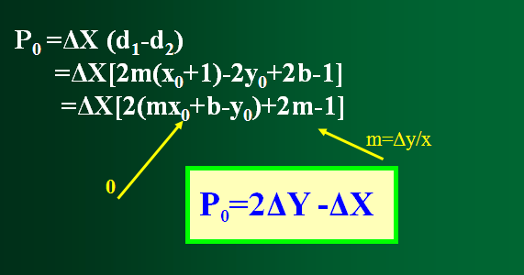
Bresenham’s Line Drawing Algorithm
This recursive calculation of decision parameters is performed at each integer x position, starting at the left coordinate endpoint of the line.
The first parameter, p0, is evaluated from the equation at the starting pixel position (x0, y0) and with m evaluated as dy/dx:

Slide 13
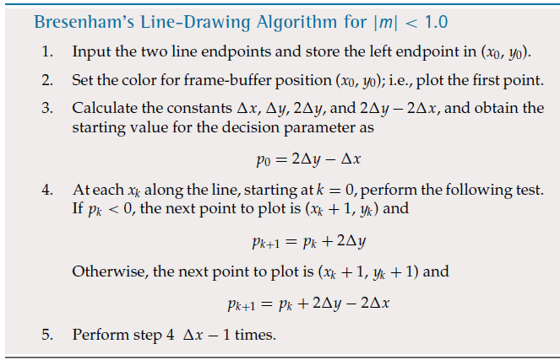
Bresenham’s Line Drawing Algorithm

Slide 14
Example
To illustrate the algorithm, we digitize the line with endpoints (20,10) and (30,18). This line has slope of 0.8, with
    Δx = 10
    Δy =8
The initial decision parameter has the value
    p₀ = 2Δy − Δx = 6
and the increments for calculating successive decision parameters are
    2 Δy = 16
    2 Δy - 2 Δx = -4

Slide 15
Example
We plot the initial point (x₀ , y₀)=(20,10) and determine successive pixel positions along the line path from the decision parameter as
K | p_{k} | (x_{k +1}, y_{k +1}) | K | p_{k} | (x_{k +1}, y_{k +1})
0 | 6 | (21,11) | 5 | 6 | (26,15)
1 | 2 | (22,12) | 6 | 2 | (27,16)
2 | -2 | (23,12) | 7 | -2 | (28,16)
3 | 14 | (24,13) | 8 | 14 | (29,17)
4 | 10 | (25,14) | 9 | 10 | (30,18)

Slide 16
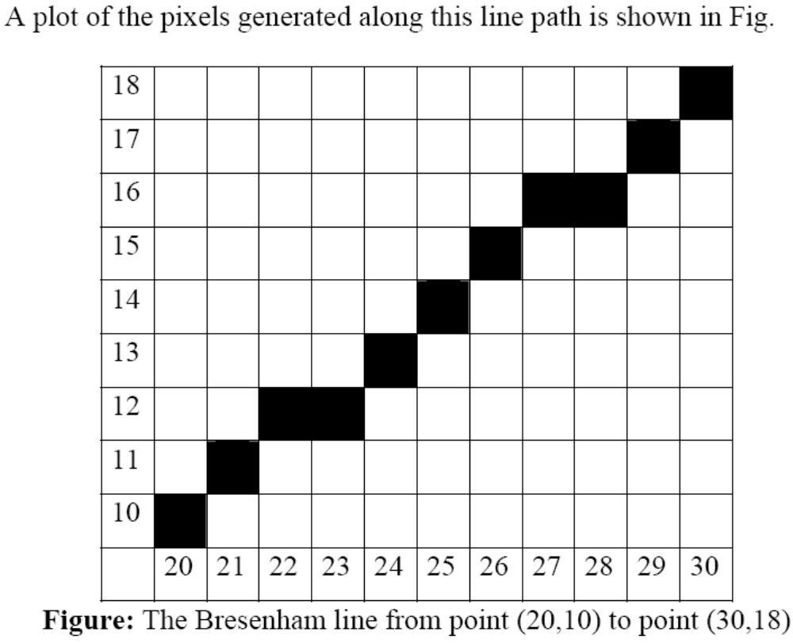
Example

Slide 17
Thank You…

